Slide 1
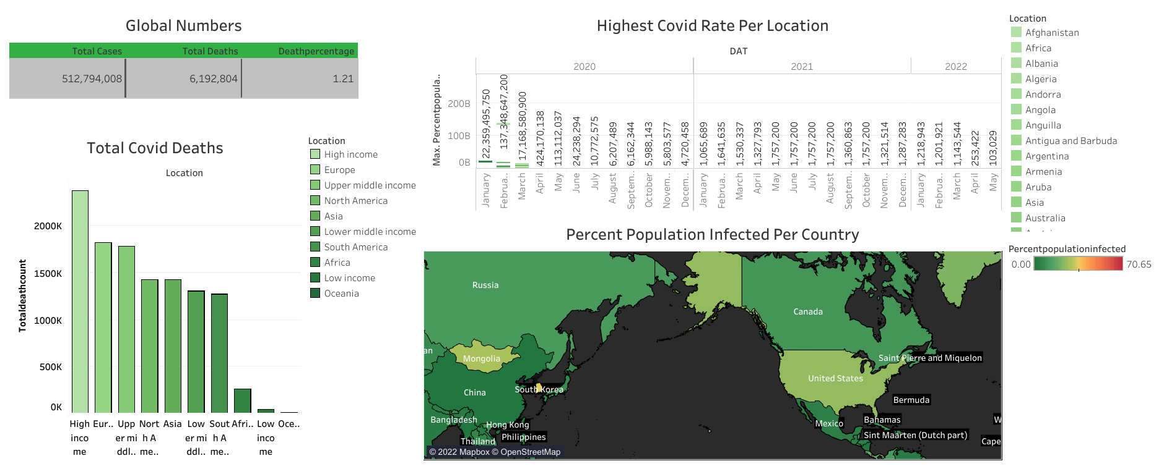
Covid 19 Dashboard

